Slide 1




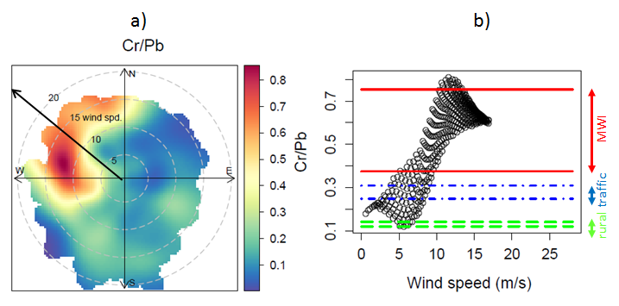
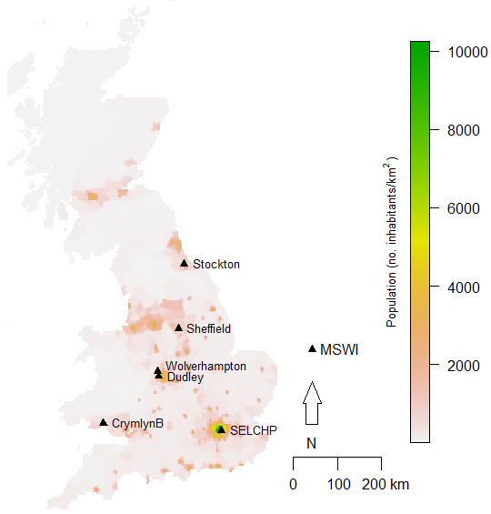
Visual Guideline for ISAB posters
Title font: Arial, bold 54
Author font: Arial, bold 32
Affiliation:
Font: Arial, 24
Epidemiology and Biostatistics, MRC-PHE Centre for Environment and Health, Imperial College London
Environmental Research Group, MRC-PHE Centre for Environment and Health, King’s College London
Analytical & Environmental Sciences Division, MRC-PHE Centre for Environment and Health, King’s College London
Surgery and Cancer, MRC-PHE Centre for Environment and Health, Imperial College London
National Heart and Lung Institute, MRC-PHE Centre for Environment and Health, Imperial College London
Content
Headers font: Arial bold, 30-34
Main Body font: Arial, 22-24 justified
Figure and Table Caption: Arial, 20 justified
Headings
Please ensure the title and content are in line with the “MRC-PHE Centre for Environment” and the funder logos
Use the following headings if possible.
  Background
  Objective
  Methods
  Results
  Conclusions
  Acknowledgements
If you do not wish to present your poster this way and use other headings, please do not deviate too far from the original suggested headings.
Figures and Tables
Figure and table caption to be above the table/figure
When referencing the tables and figures in the main text, use the following denotation:
(Table 1) or (Fig. 1)
Main content
Do not over clutter the poster with text. Be concise.
Keep the font sizes consistent.
A smaller font can be used for acknowledgement and references
Reference style is up to you, but must be consistent throughout.
MRC-PHE
Centre for Environment and Health
Title title title title title title title title title title title title titletitle title ti title title tititle title ti
Author Author¹, Author author ^{2,3,4}, Author author^{3,}, Author author^{3,}, Author author^{3,} , Author author ^{4,7}, and Author author¹
¹ Environmental Research Group, MRC PHE Centre for Environment and Health, King's College London, London, UK; ² Swiss Tropical and Public Health Institute, Basel, Switzerland; ³ University of Basel, Basel, Switzerland; ⁴ Small Area Health Statistics Unit, MRC PHE Centre for Environment and Health, Imperial College London, London, UK; ⁵ Department of Epidemiology and Biostatistics, MRC PHE Centre for Environment and Health, Imperial College London, London, UK; ⁶ Analytical Science Division, National Physical Laboratory, Teddington, UK; ⁷ Directorate of Public Health and Primary Care, Imperial College Healthcare NHS Trust, London, UK
Background
Main body text, Main body text, Main body text, Main body text, Main body text, Main body text, Main body text, Main body text, Main body text, Main body text, Main body text, Main body text, Main body text, Main body text, Main body text, Main body text, Main body text, Main body text,
Main body text, Main body text, Main body text, Main body text, Main body text, Main body text, Main body text, Main body text, Main body text, Main body text, Main body text, Main body text,
Objective
Main body text, Main body text, Main body text, Main body text, Main body text, Main body text,
Methods
Main body text, Main body text, Main body text, Main body text, Main body text, Main body text, Main body text, Main body text, Main body text, Main body text, Main body text, Main body text, Main body text, Main body text, Main body text, Main body text, Main body text, Main body text,
, (Table 1).
Results
Main body text, Main body text, Main body text, Main body text, Main body text, Main body text, Main body text, Main body text, Main body text, Main body text, Main body text, Main body text, Main body text, Main body text, Main body text, Main body text, Main body text, Main body text,
ain body text, Main body text, Main body text, Main body text, Main body text, Main body text,
Main body text, Main body text, Main body text, Main body text, Main body text, Main body text, Main body text, Main body text, Main body text, Main body text, Main body text, Main body text, Main body text, Main body text, Main body text, Main body text, Main body text, Main body text,
Main body text, Main body text, Main body text, Main body text, Main body text, Main body text,
Main body text, Main body text, Main body text, Main body text, Main body text, Main body text, Main body text, Main body text, Main body text, Main body text, Main body text, Main body text, Main body text,
Fig. 2n Table figure caption Table figure caption Table figure caption Table figure caption Table figure caption Table figure caption Table figure caption Table figure caption Table
Table 1 .Table figure caption Table figure caption Table figure caption Table figure caption Table figure caption Table figure caption Table figure caption
Ratio | MWI mean ± 2σ | Rural mean ± 2σ | Traffic mean ± 2σ
Cu/Cd
Cd/Pb
Cr/Pb
Cu/Pb
Figure 1. Table figure caption Table figure caption Table figure caption
Main body text, Main body text, Main body text, Main body text, Main body text, Main body text, Main body text, Main body text, body text,(Fig. 1).
Main body text, Main body text, Main body text, Main body text, Main body text, Main body text, Main body text, Main body text, Main body text, Main body text, Main body text, Main body text, Main body text, Main body text, Main body text, Main body text, Main body text, Main body text, Main body
Table 2. Table figure caption Table figure caption Table figure caption Table figure caption Table figure caption Table figure caption Table figure caption Table figure caption Table
I | fsdfsdf | % time with wind from MWI under stable conditions | % of the study period
Crymlyn Burrows | dfsdf
Dudley | sdfsdfs
Dudley | sdfsdfdg
Stockton-on-Tees | dfgdfg
Sheffield | dfgdfg
SELCHP | London Westminster
Wolverhampton | Walsall Bilston Lane
Wolverhampton | Walsall Centre
Main body text, Main body text, Main body text, Main body text, Main body text, Main body text, Main body text, Main body text, Main body Main body text, Main body text, Main body text, Main body text, Main body text, Main Main body text, Main body text, Main body text, Main
Conclusions
Main body text, Main body text, Main body text, Main body text, Main body text, Main Main body text, Main body text, Main body text, Main body text, Main body text, Main body text, Main body text, Main body text
Main body text, Main body text, Main body text, Main body text, Main body text, Main Main body text, Main body text, Main body text, Main
Acknowledgements This research was funded by Public Health England (PHE). We would like to thank the UK Environment Agency (EA) for the electronic version of emissions data from MWIs; and also the project scientific advisory committee for their valuable comments.
References ⁽¹⁾ CIESIN, 2005.
MRC-PHE Centre for Environment and Health
^{www.environment-health.ac.uk}

